Slide 1
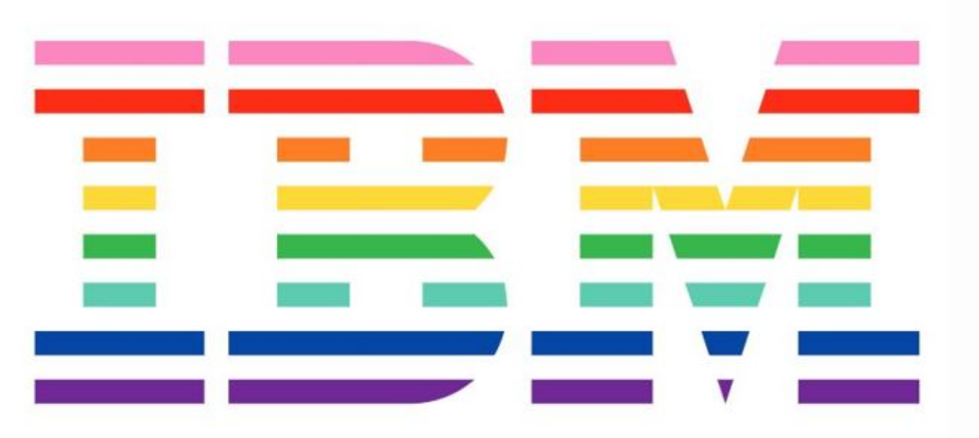

Slide 2
Adventures in Async: Part II Building Stateful Microservices with Akka and K8s TALK mary.grygleski@ibm.com Grant Steinfeld Twitter: @gsteinfeld IBM Developer Advocate Java & Blockchain

Slide 3
Agenda 6:30 – 7pm Networking, Food 7:00 – 8:15pm Presentation and Technical demonstration 8:20 – 8:45 Q&A 9:00 - Wrap

Slide 4

IBM Developer Advocate
Java JVM and Blockchain
Notes:
My History
25 years entr[ross dev
Distributed systems expected to
Scale, be fault tolerant, jave backups/warm standbys
Using tech on the 90s
Heavy use of MOM
No real centralized logging
”B
10 years ago Scala
Actor model – moved from 1 JVM
Learn new paradigm Actors
Primary to Secondary
Secondary failovers sometimes fail too!!! ( same code base – errors propagated )
Epiphany - for me was building Chatbot/msg system on Erlang 4 years ago at Pypestream

Slide 5

What is Reactive?
The Reactive Manifesto
Published on September 16 2014. (v2.0)
Organizations working in disparate domains are independently discovering patterns for building software that look the same.
These systems are more robust, more resilient, more flexible and better positioned to meet modern demands. ... We call these Reactive Systems.
https://www.ReactiveManifesto.org/
Notes:
Asynchronous Backends

Slide 6
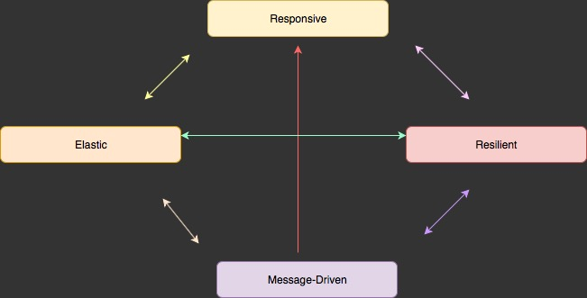
4 Reactive Principles

Slide 7
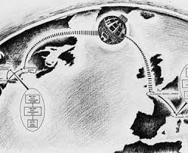
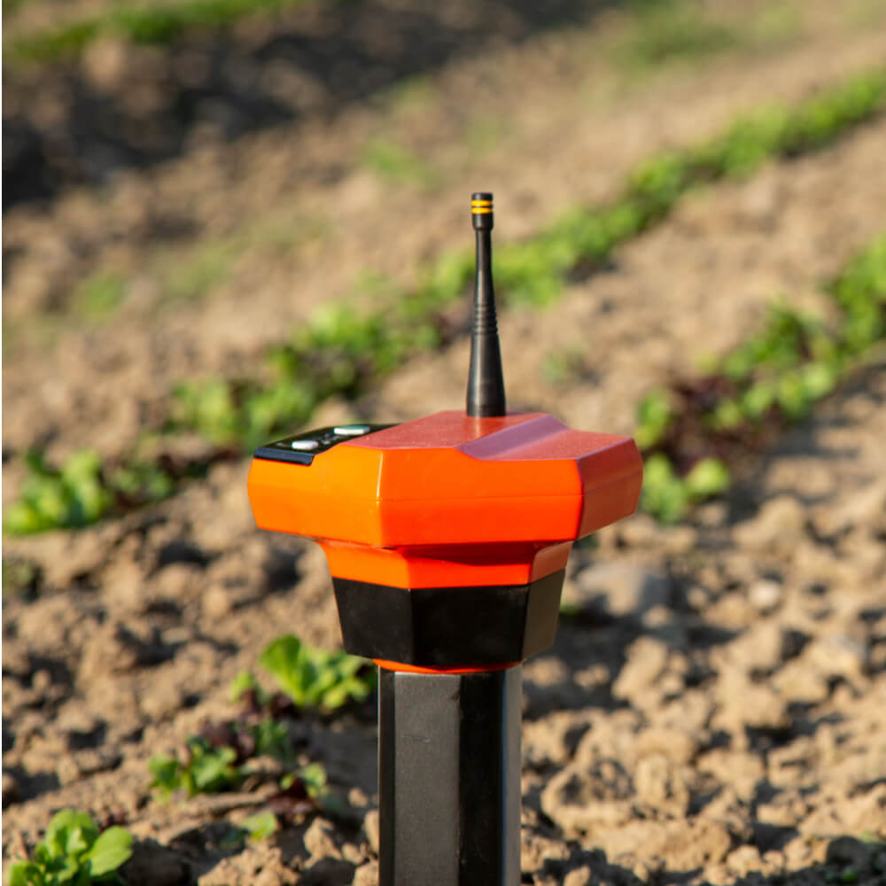
Acme Agrigate - Digital Farming Data Platform Hypothetically an IoT sensor metric real-time aggregator ~ 10 Million sensors – gps/temp/soil moisture ~ Million messages/minute ~ 99.9% reliablity
Reactive System Example
Notes:
OLTP server
Precision agriculture
Soil moisture probes
combines various technologies for water management into one central, cloud based, and powerful location designed for consultants and growers to take advantage of the benefits in precision irrigation via a simplified interface.

Slide 8
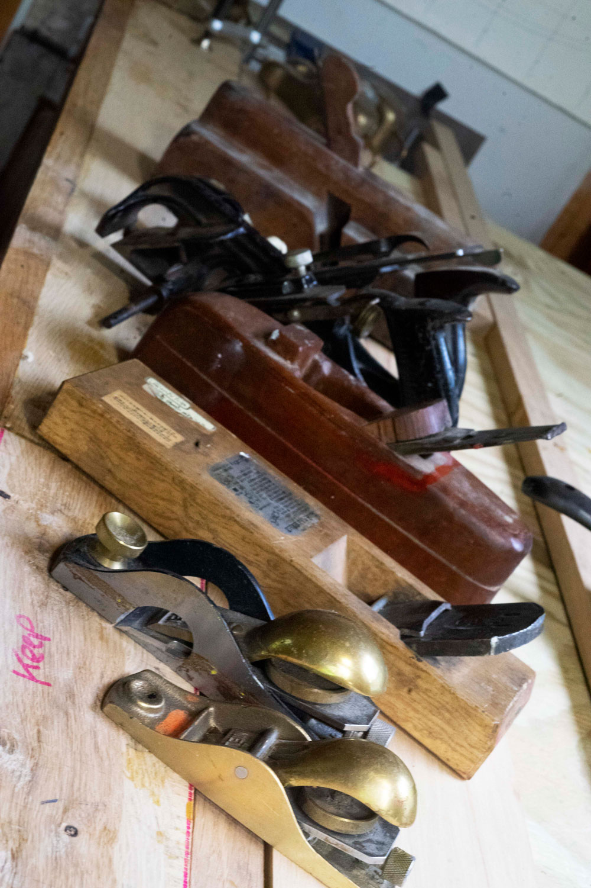
How do we build such a system?
Best fit Technology Stack
Architectural alternatives
Team size, skillset
Resources
Notes:
Knowledge of your
Technical and Product roadmap – Architects and Developers prepare to think what tools and methodologies to use to meet the business requirements

Slide 9

We propose a Reactive Stateful Microservice Architecture Act 1.
Kubernetes enter stage left

Slide 10
Kubernetes
Observed ⬄Desired State
Notes:
Kubernetes is based on the concept of balancing the current state and the desired state, where the desired state is what you want your production environment to be, in other words, how many servers you want to be up and running for your application. The current state means the current status of your production environment.

Slide 11
Kubernetes
Mature Containers Orchestration Toolkit
Notes:
Kubernetes is based on the concept of balancing the current state and the desired state, where the desired state is what you want your production environment to be, in other words, how many servers you want to be up and running for your application. The current state means the current status of your production environment.

Slide 12

Kubernetes – development mode
Notes:
Million ways to Sunday to run K8s
Poll audience
Do they run k8s
How do they run it?
Istio, Rancher
Cloud
Locally
Minikube
Openshift
Minishift
OKD is a distribution of Kubernetes optimized for continuous application development and multi-tenant deployment. OKD also serves as the upstream code base upon which Red Hat OpenShift Online and Red Hat OpenShift Container Platform are built.

Slide 13

Docker Containers
Where our Stateful Microservice
Akka Actor application will run and be managed by K8s
Notes:
Where my JVM lives
Java 8
Maven
JVM

Slide 14
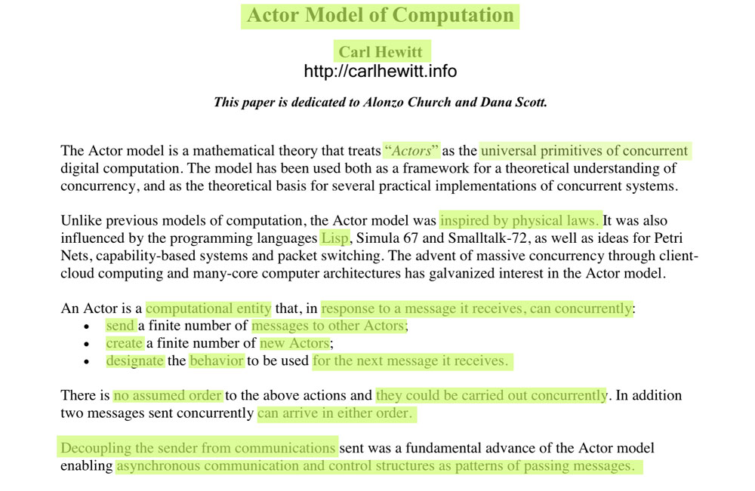
Actor Model Origins - 1977
Notes:
https://arxiv.org/ftp/arxiv/papers/1008/1008.1459.pdf
https://en.wikipedia.org/wiki/Lambda_calculus
Alonzo Church created lambda calculus
- 1930 influenced LISP programming lang and functional programming

Slide 15
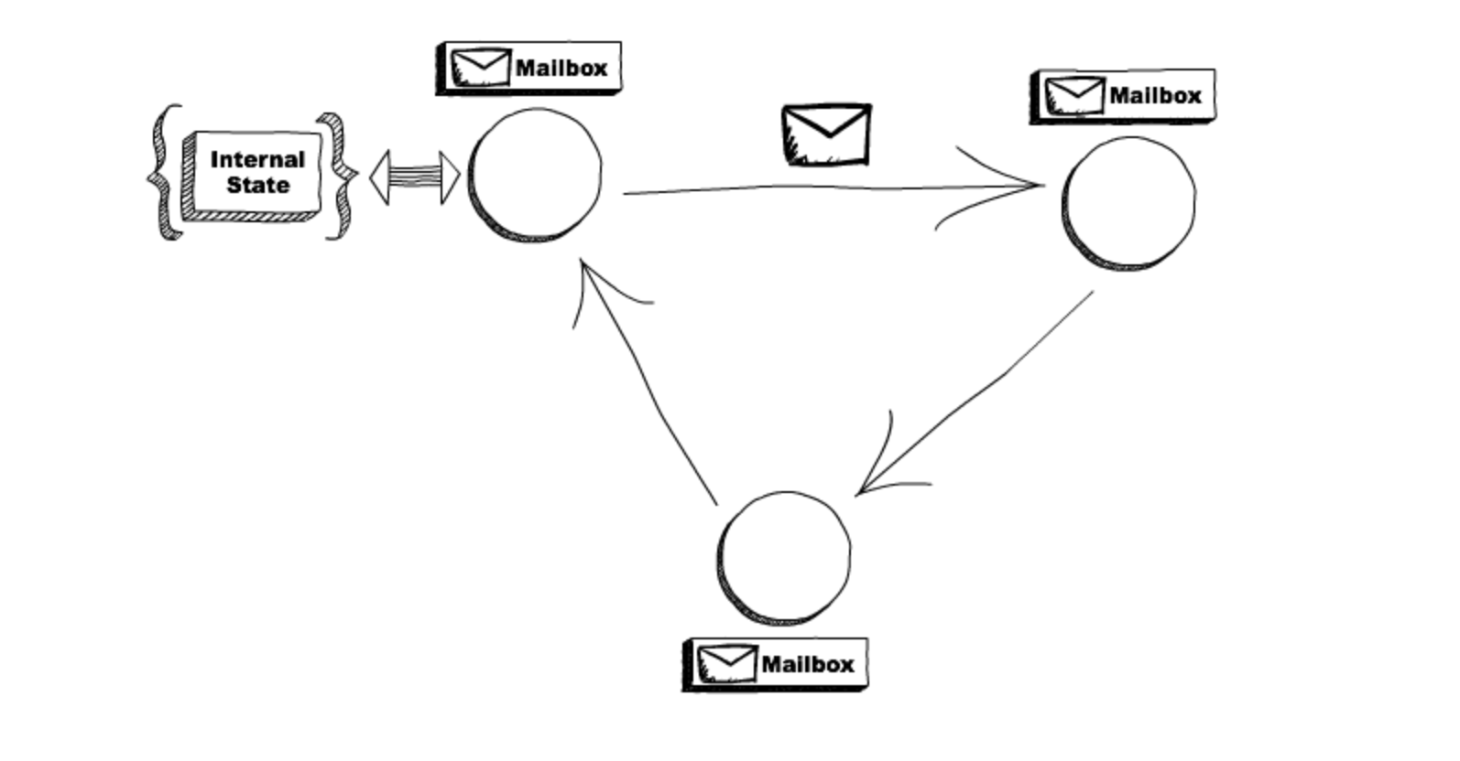
What is an Actor in software architectures?

Slide 16
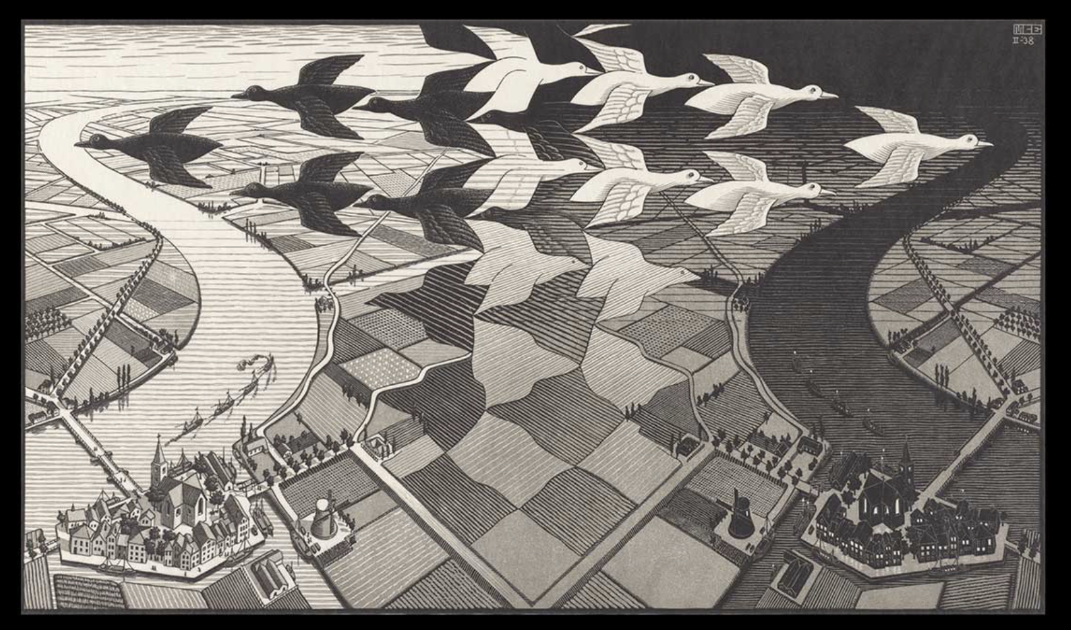
Actor Model
One ant is no ant
One actor is no actor
Ecosystem of multiple actors!
Message Flow

Slide 17
Actor Model
Each actor has a mailbox ( sequential queue )
Sequential processing in an individual actor
Message Flow

Slide 18
Actor Model
3 OPTIONS:
Create another 1-n new actors
Send messages to other actors
Mutate!
Designate what to do with the message ( can change it’s behavior ) → code example
ON_MESSAGE()
Message Flow

Slide 19
Supervisory Tree joins forces with K8s
Demo
//Scale out
/ /Scale in
Message Flow
Notes:
Self healing
Self balancing
One Ant

Slide 20
Supervisory Tree
Ecosystem
Self healing
Elastic
Stateful
Timeout
//CODE
Message Flow

Slide 21
Shard Actors
Lru?
Notes:
Name lamda params carefull is essential to the readibiity of stress pipelins
Use helper methods is more NB for readability in stream pipelines that in iterative code!

Slide 22
Entity Actors
Lru?
Notes:
Name lamda params carefull is essential to the readibiity of stress pipelins
Use helper methods is more NB for readability in stream pipelines that in iterative code!

Slide 23
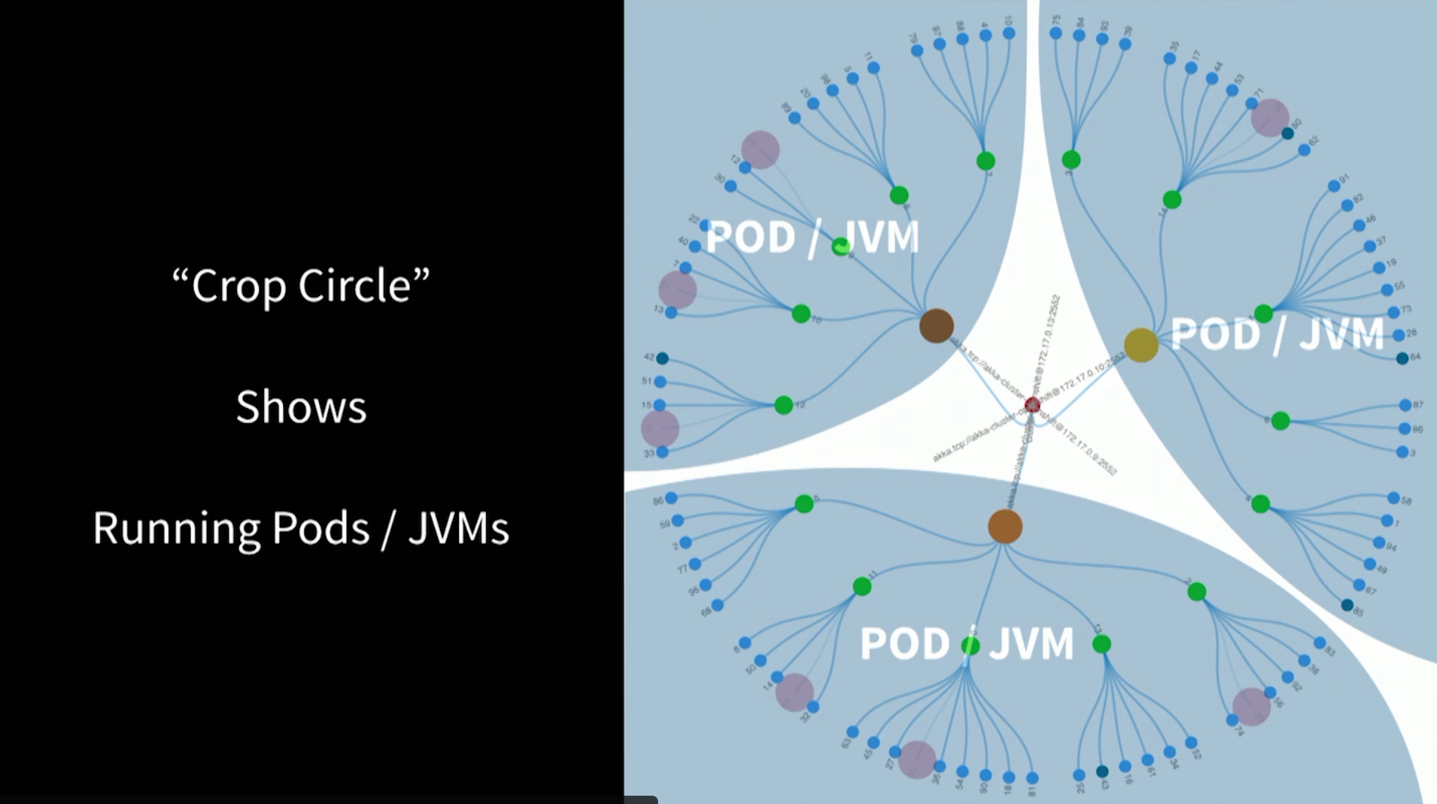
Demo – d3 visualization
Each Kubernetes Pod runs a single JVM

Slide 24
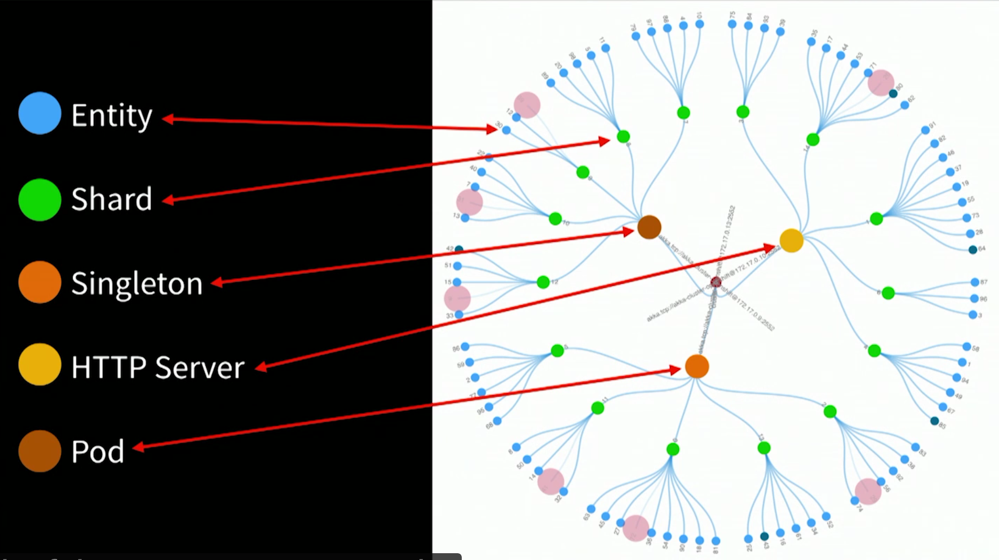
Demo – d3 visualization
Notes:
Microservice out on the perimeter Blue dots
State – banck occont or shopping cart or IoT device

Slide 25
POJ app - Maven
POM.xml
Dependancies
Line 162 Shade – Jar Jar – to run in K8s – defines main()
Line 202 – creates Docker image – ports
8080
8558
2552
Message Flow
Notes:
Docker init start jar
Runner.java
Main akka system glorified thread pool
Starts some basic actors

Slide 26
k8s
2 yaml file
Akka-cluster-deployment
…
Line 7 Docker image name and tags
…
Message Flow
Notes:
I am not k8s expert yet!
Just want to run my jars
Don’t bore me with networkdeets
Just run myJvm
Reactive – not just async
Reactive systems
Always up

Slide 27
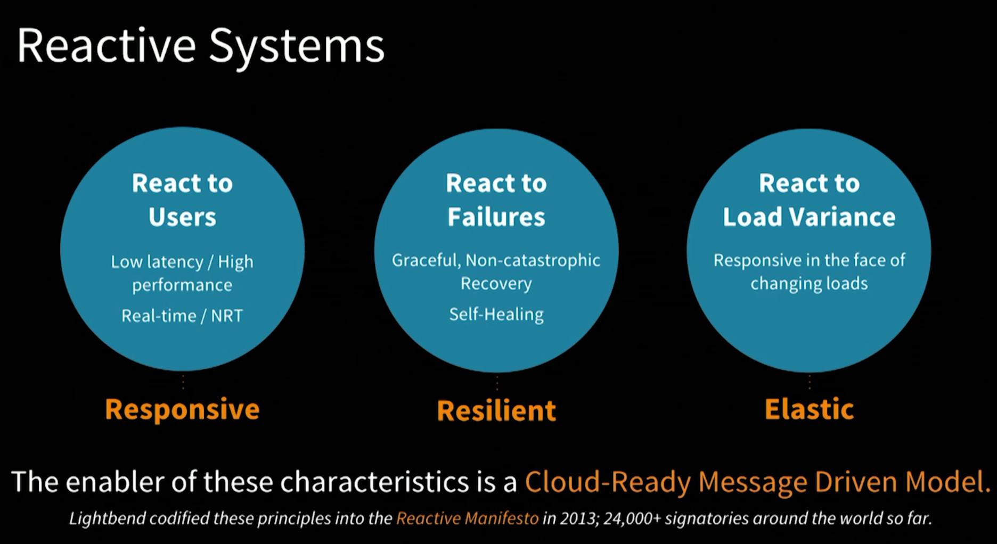
Reactive Systems - WOW
Message Flow
Notes:
K8s auto scale
Outside
Akka see more nodes = more capacity spread the work load
Inside

Slide 28
K8s pod changes
//Show GUI
Message Flow
Notes:
demo scale up
Demo scale down
More pods more JVM – load is spread – take a bit to com live
Drift over akka see’s these JVMs
Little pain
Akka drifts load over
K8s start up new JVM
Demo sjow lost pod
Missing part – k8s hlps
Not Akka
The beauty relationip

Slide 29
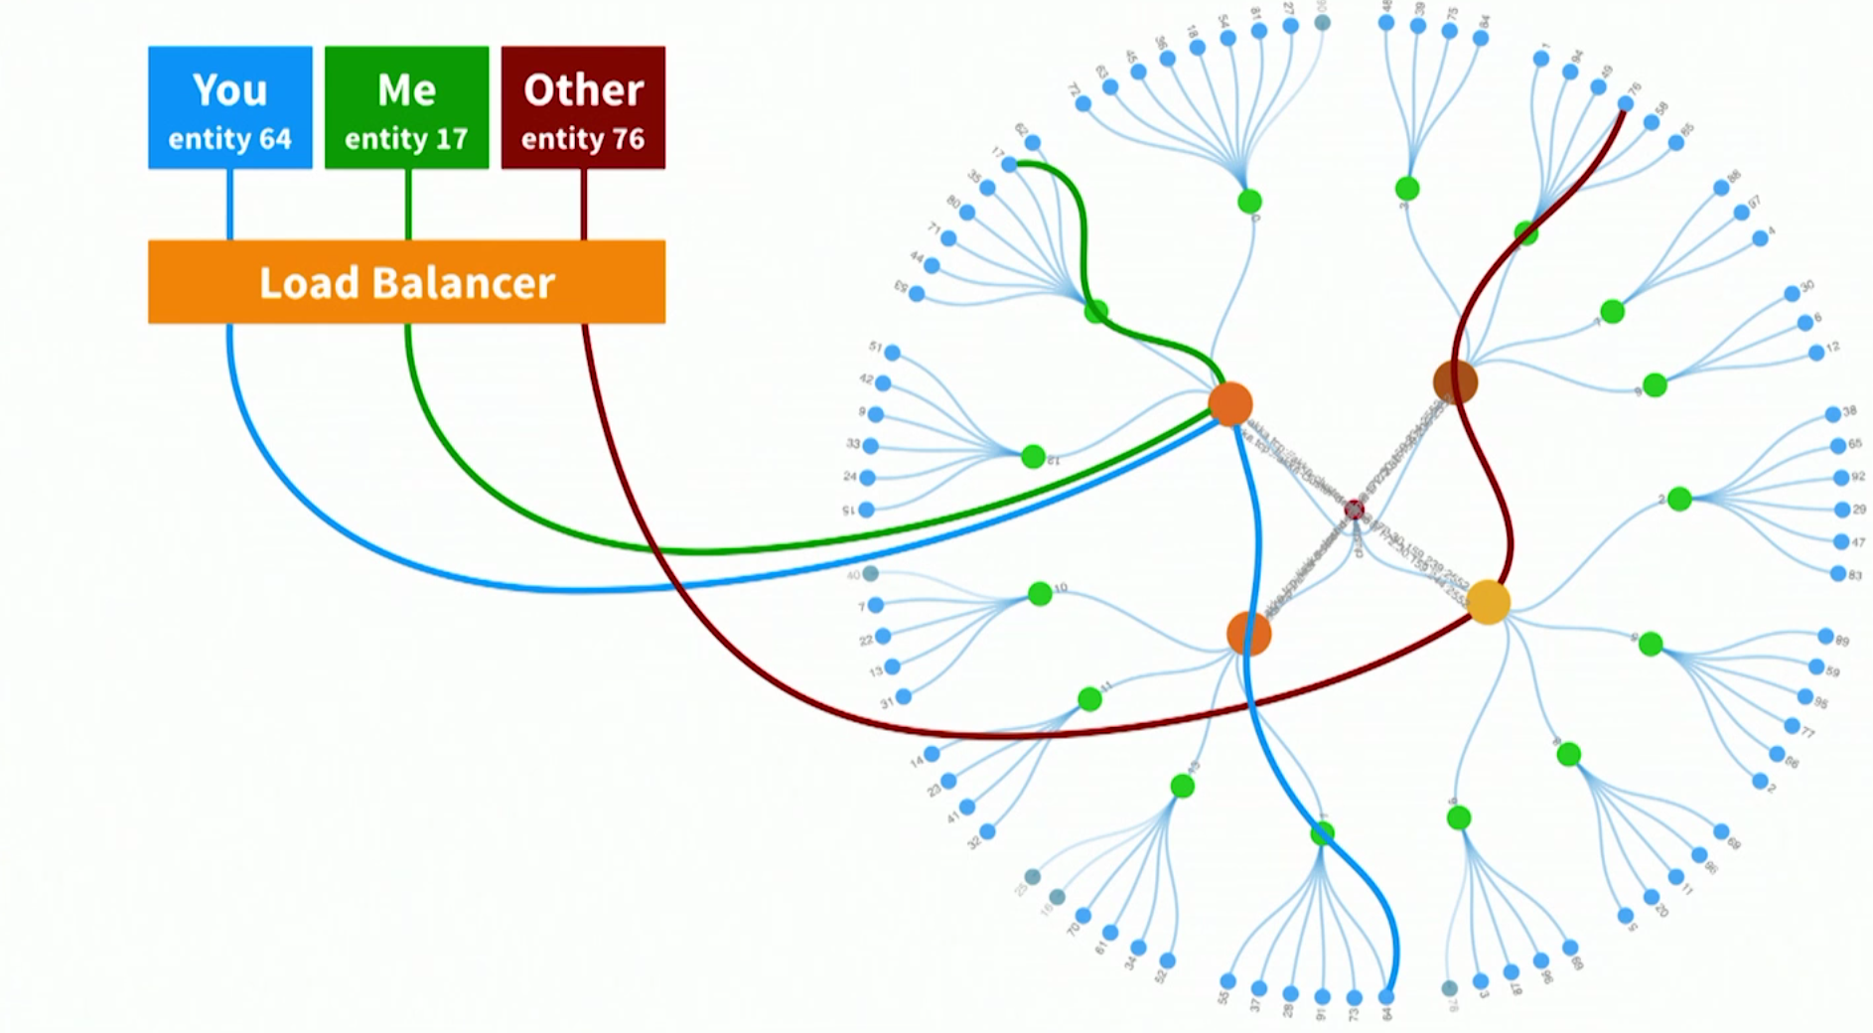
Cluster entity actors
Message Flow
Notes:
Client doing stuff on specific entity
Client does something on entity 64
Quick lookup – is this in this jVM – in other JVm request fwd
Blue line what shard
Is this mine
Is actor is alive
If yes fwd
If not creates actor – recovers state from DB –
Or most likely from
Event sourcing or CQRS

Slide 30

Event sourcing and CQRS
Command Query Responsibility Segregation
Message Flow
Notes:
Command Query Seperation
The term 'command query separation' was coined by Bertrand Meyer in his book "Object Oriented Software Construction" - a book that is one of the most influential OO books during the early days of OO.
Command(s) MUTATORS
At its heart is the notion that you can use a different model to update information than the model you use to read information.
Or aggregate collapse into one – Redis HyperLogLog
Real life example --- Air Traffic Management (ATM) domain. We designed a solution for an ANSP, an Air Navigation Service Provider in charge to control a specific geographical area. The goal of the application was simple: compute and persist flight data.

Slide 31
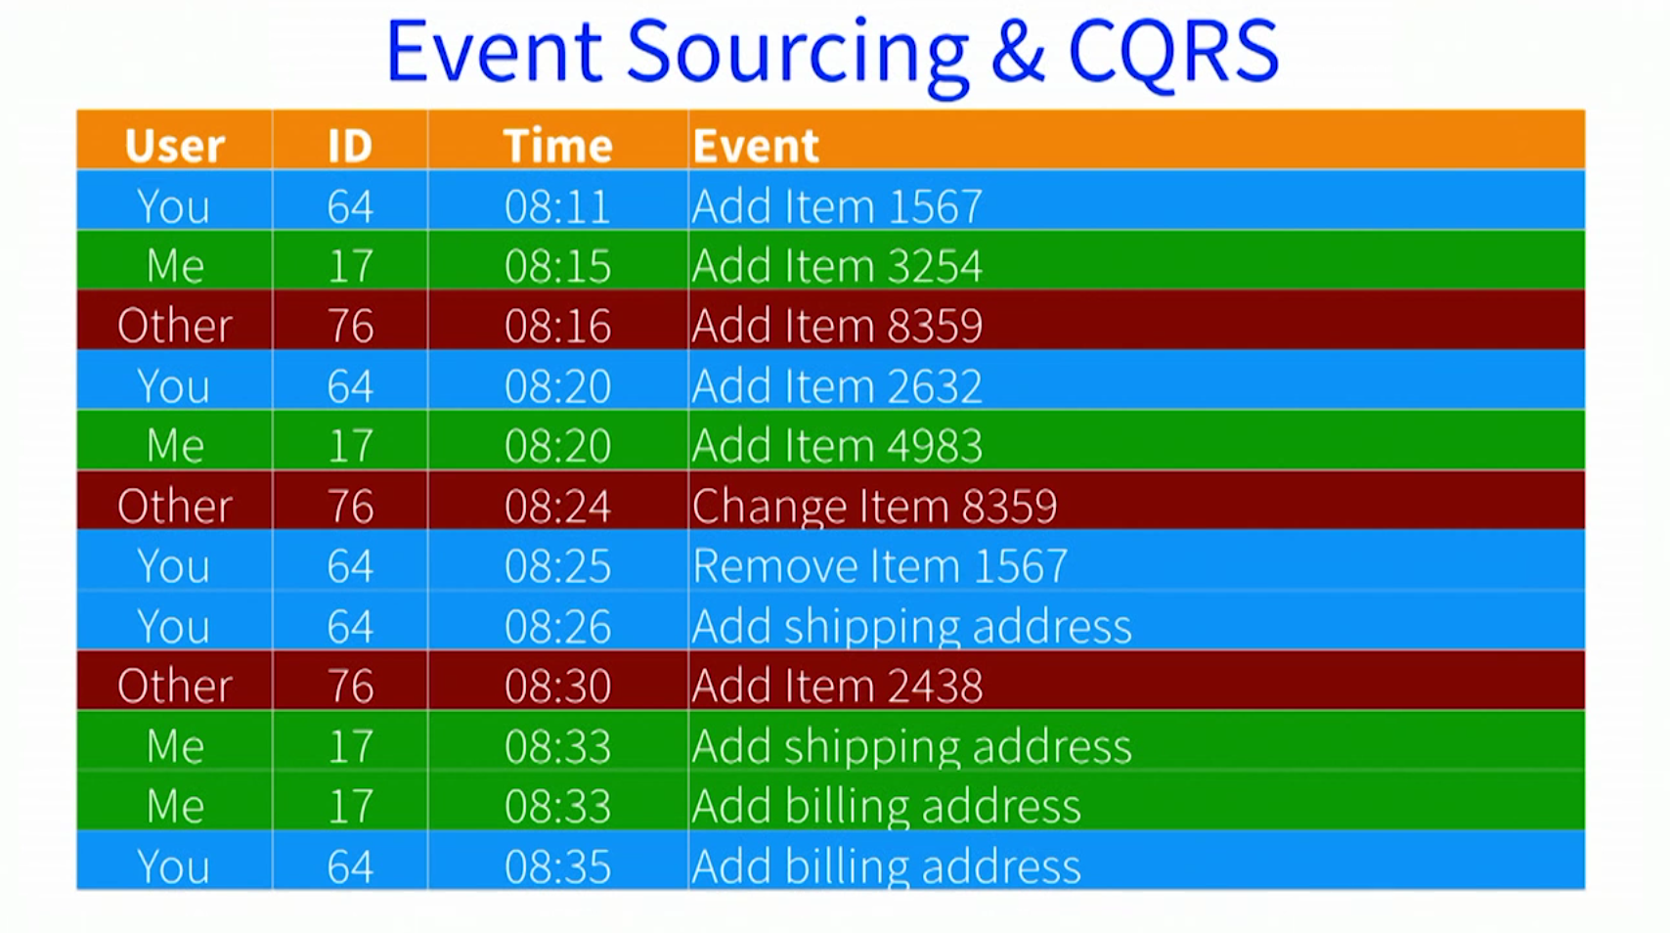
Event sourcing and CQRS
Command Query Responsibility Segregation
Message Flow
Notes:
Used a lot at customers
:
Store events not a db table
To get current state – replay events ( including –ve data like deletes – more interesting to data scheinctists )

Slide 32
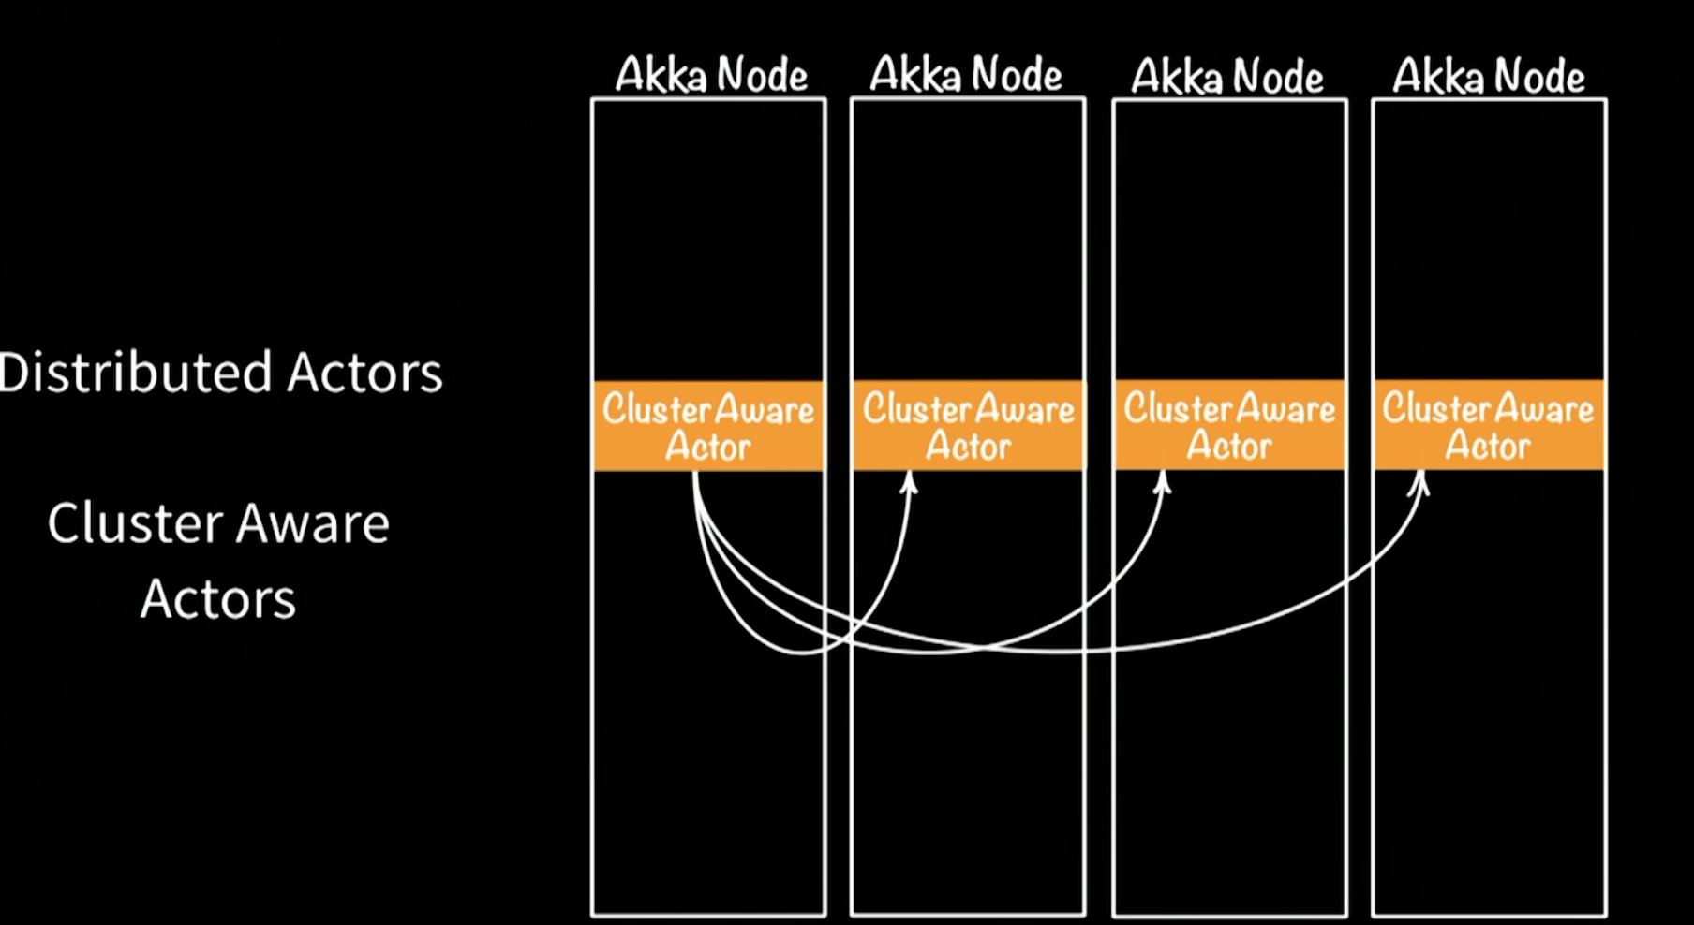
Cluster Aware Actors

Slide 33
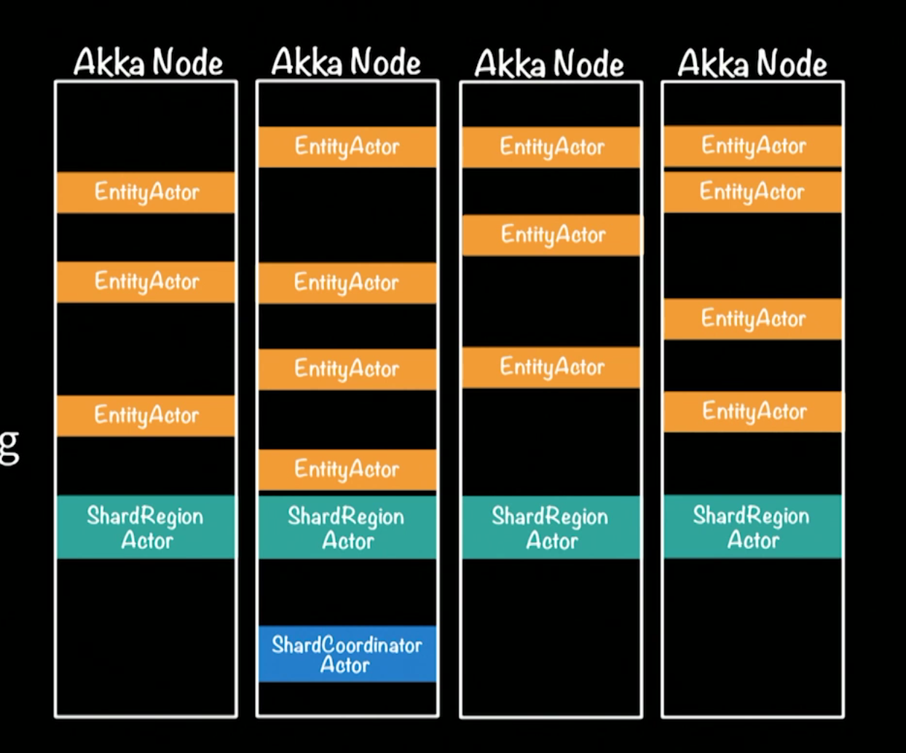
Akka Entity Distributed sharding
Notes:
Moer interesting shard region dist messages to right place in ecosystem
Entity only place where change – actor is the concurrency ‘multi-thrading’ only a single actor ( eg #67 )
Akka persistence – Cassandra etc -
But event log
Write side
Read side

Slide 34
Entity Command actor extends AbstractLoggingActor
View code
Message Flow
Notes:
Simple
Indirect message async – like texting
Sends message to itself
tickSending() line 49
getContext().become
Delegate routing to another actor shard region actor ( out of box ) - routhing
Tell() sends message
No http part – but has receiver to endpoint
Typed strongly – when receive command for 64
e.g. sensor event ( RAM ) no db in this example 9 but could
Highly optimized
10 years
40 000 000 msg/JVM

Slide 35

Q&A
Customers
Paypal 1 Billion Tx/Day
Bad to block – does it block – how to tell if it’s alive
Actors async – should be quick op – ‘stuck thread’
Thread starvation tool ( broken ? ) / DB sync?
Dispatchers thread pools
Some for blocking
Some for non-blocking
MAIL box
Reactive streams – backpressure if down stream slower slow down producer Akka is Java/Scala
Written in Scala – Java and Scala API
Examples Java
GitHub - Scala
Notes:
Be aware of blocking!

Slide 36
Resources code for this presentation https://github.com/mckeeh3/akka-java-cluster-openshift Reactive https://developer.ibm.com/technologies/reactive-systems/ https://www.reactivemanifesto.org/ https://martinfowler.com/bliki/CQRS.html Akka Actors https://doc.akka.io/docs/akka/current/actors.html Kubernetes – OpenShift – Minishift https://www.okd.io/minishift/ CQRS/EVENT SOURCING https://martinfowler.com/bliki/CommandQuerySeparation.html https://cqrs.files.wordpress.com/2010/11/cqrs_documents.pdf

Slide 37

New!! More Adventures in Async! Part III – Akka Streams, Lightbend Lagom,IBM Reactive Platform offering ( ~July ) Part IV – Apache Kafka and Reactive systems ( ~August ) other meetups, workshops, interactive webinars
Check in periodically at https://developer.ibm.com/events/

Slide 38
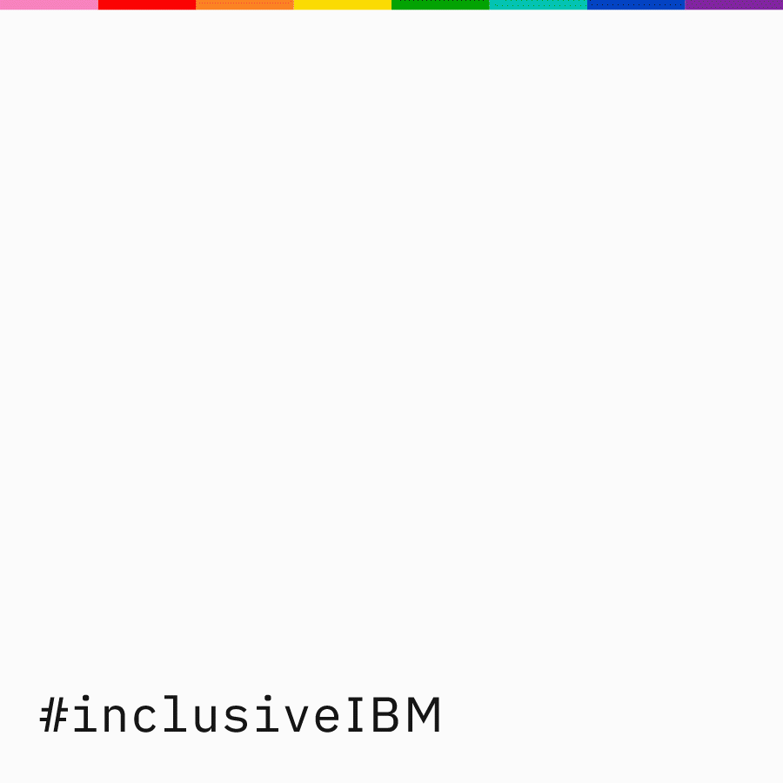
#inclusiveIBM
Notes:
Call out to Pride month

Slide 39

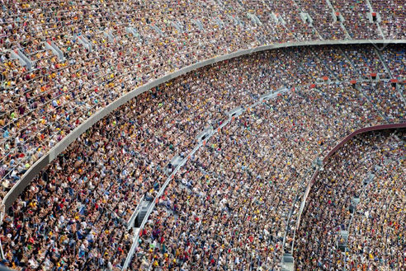

Thank You
Sign up onto the ibm cloud platform to experiment with OpenShift on Red Hat and try out the IBM reactive systems https://ibm.biz/BdzzGe
twitter.com/gsteinfeld
https://github.com/grant-steinfeld
https://developer.ibm.com/profiles/grant.steinfeld

